Slide 1
Introduction to ASSEMBLY AND MACHINE INSTRUCTIONS
IT 301

Slide 2
Assembly and machine instructions
Speaking your computer’s language
Notes:
So far in this class you have focused programming in a high-level language like Java. You have probably given little to no thought to what happens at the machine level and exactly how does your high level language get turned into 1 and 0's. That is the learning focus of this week's module.

Slide 3
What is Assembly Language?
Before compilers were available, many programmers coded in assembly language
assembly is the closest a programmer can get to coding at the machine level without resorting to coding with 1's and 0's
boot sequences for computers are still written in assembly code today
operating systems often contain hand-written assembly for thread or process context-switching
a working knowledge of assembly is essential for software developers to reverse engineer malware

Slide 4
Assembly Language
Common Features
The Instruction Set Architecture defines the assembly language
CPU Registers hold data – some are read/write others are read-only
Instructions specify what the CPU can do – have operation codes (opcodes)

Slide 5

Instruction Sets (computer's language)
Instruction set: the set of commands that a CPU will respond to
Types of commands (in assembly)
Arithmetic: add, sub, mult, div, …
Logical: and, or, xor, not, …
Control flow (decisions, loops): branch, jump
Assignment: load, store
Instruction sets by name
MIPS
Intel x86-x64, …
Notes:
ISA – instruction set architecture – the specific operations in assembly language directly supported by the circuitry of the chip
ISA is the interface between the hardware and the software
Consists of four types of commands…
Different types of ISAs, although most are very similar. Instead of being different "languages", they are more like different "dialects" of the same language.

Slide 6
CPU Registers
Each machine architecture has a small finite number of registers
Fast memory locations
Hold data before and after they are used by the CPU
registers
operand 1
ALU
operand 2
Small number of registers
Example:
MIPS has 32
MIPSzy has 8
result
Notes:
Closest to the CPU, which is where the action happens, are a small limited number of memory locations called registers.
These registers have to be big enough to hold a word.
They are located close to the CPU because this way, they have the shortest distance to travel when the CPU needs the data they hold.
It also clarifies why there is a small number – can't fit a lot of registers close to the CPU. Increasing the number of registers means moving them further from the CPU, which increases the distance that signals have to travel from the registers to/from the CPU – which translates to increased time/slower performance.
Also, more registers affects the format of an instruction since as we'll see, the names of registers are usually included in instructions.

Slide 7
Code translation
calculate(int n1, int n2)
{ int prod = n1 * 4;
prod = n2 + prod;
return prod;
}
compiler
calculate:
muli $2, $5,4
add $2, $4,$2
sw $16, 0($2)
j $31
compiler
assembler
00000000101000010000000000011000
00000000000110000001100000100001
10001100011000100000000000000000
10001100111100100000000000000100
10101100111100100000000000000000
10101100011000100000000000000100
00000011111000000000000000001000
Each higher level abstracts away the complexity of the lower level
Notes:
high-levels: easier for humans,
lower-level: more efficient
these days, well-designed compilers for higher-level languages are being made that produce code that is comparable to what low-level/assembly programmers can produce by hand
gives you an idea of what different levels produce
compilers can skip the assembly level and compile straight to machine code

Slide 8
Assembly and machine code
Machine language: binary instructions that a CPU can directly execute
1000110010100000
Assembly language: symbolic representation of machine code instructions
addi $t1, $t2, 4
High level language: modern languages like C++ or Java
eg. A = B + 4
Conversion between languages
Assembler: converts assembly code to binary machine code
Compiler: converts high level code to assembly or machine code
Levels of Abstraction
Assembly language
High level language
Machine language
compiler
assembler
CPU
Notes:
As software developers (unless you are writing system-level programs), we typically work with high-level languages. They are "high-level" because the levels of complexity below them have been "abstracted" away from us.
If we deliberately look at these levels, we find that our high-level language is often compiled to a low-level programming language known as assembly. Assembly is a symbolic representation of machine code, which we know if composed of 1's and 0's.
We get from assembly language to machine language using an assembler. Once at machine code, the CPU can read it.
In computer science, you will frequently hear about "abstractions". Abstracting away implementation details of lower levels allows us to not worry about details that don't really concern us and/or aren't our specialty. Someone else has already dealt with these things so that we can use what they created without having to be able to write the details ourselves. We have that same idea of abstraction when we write Java programs – consider the classes and methods we use from libraries/packages.

Slide 9
What is MIPS?
MIPS is a reduced instruction set architecture (RISC)
MIPS is often used in colleges as it's instruction set is easier to learn
Most MIPS instructions operate on 32 registers
exception –the load/store instructions which access memory
MIPS code example:
# register t3's value + 345 is assigned to register t4
addi $t4, $t3, 345

Slide 10
MIPS Format
The opcode is followed by optional pieces of information depending upon the type of instruction
Typically opcodes represent actions like adding two register values or loading a value from memory into a register
A MIPS instruction format which could hold an add instruction addi $t1, $t0, 32456
op | rd | rs | immediate
6 bits | 5 bits | 5 bits | 16 bits
Opcode
Destination
register
Source
register
number to add to rs in
two's complement
-32768 to 32767
Notes:
format of instruction in machine language -- same #bits as in a word
broken down into fields
opcodes have 6 bits (so 64 basic ops) 2^6
registers are 5 bits (which is enough to accommodate 32 registers) 2^5

Slide 11
Example MIPS opcodes
Instruction | Opcode/Function
add | 100000
addu | 100001
addi | 001000
addiu | 001001
and | 100100
andi | 001100
div | 011010
divu | 011011
mult | 011000
multu | 011001
nor | 100111
or | 100101
Instruction | Opcode/Function
ori | 001101
sll | 000000
sllv | 000100
sra | 000011
srav | 000111
srl | 000010
srlv | 000110
sub | 100010
subu | 100011
xor | 100110
xori | 001110

Slide 12
What is MIPSzy?
MIPSzy is an even simpler version of MIPS that is in zyBooks
MIPSzy has 8 registers whose name begins with $
registers
$zero 0 read only
$t0 read write
$t1 read write
$t2 read write
$t3 read write
$t4 read write
$t5 read write
$t6 read write

Slide 13
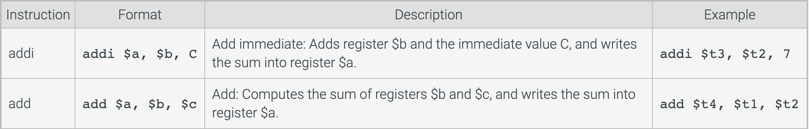
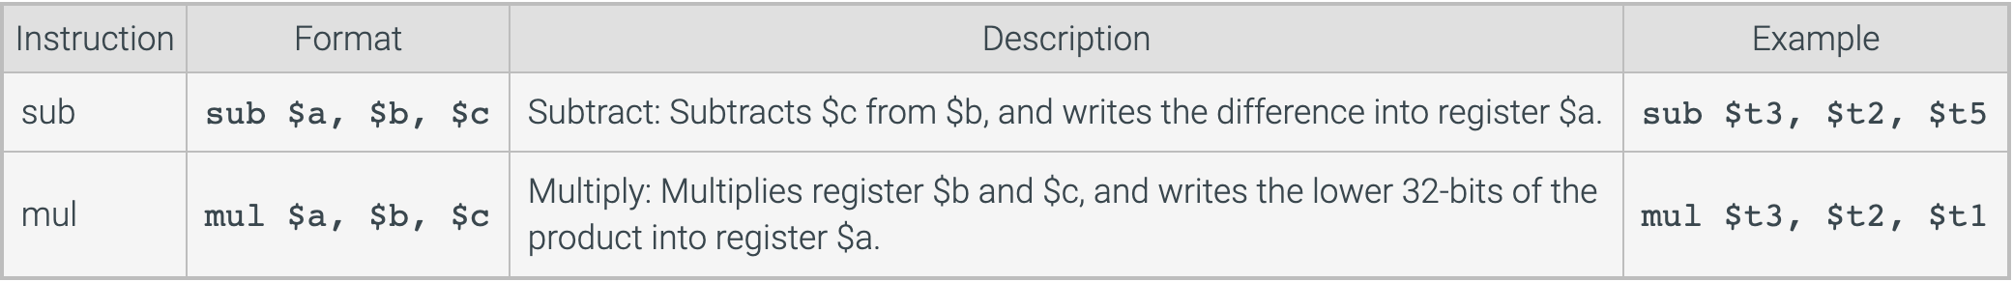
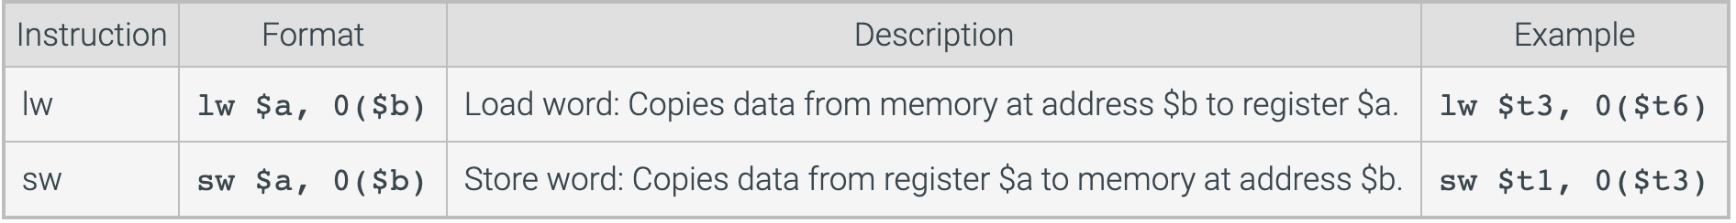
MIPSzy Instructions
registers

Slide 14
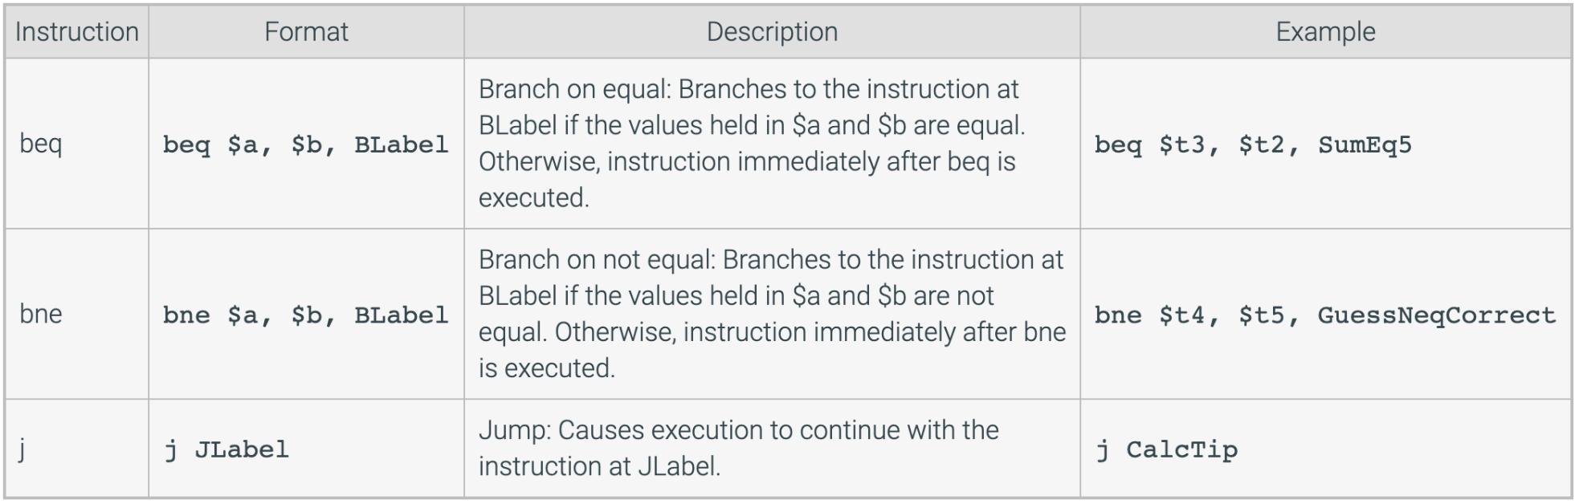
MIPSzy Instructions
registers

Slide 15
The ABC Machine
Simulate running an assembly language program on the ABC Machine

Slide 16

Architecture details
Word size: 16 bits
Main memory: 4-bit address (holds 16 words)
Registers: 8 registers
Program counter: 4 bits
Opcodes: 8

Slide 17
Instruction set
 | F | E | D | C | B | A | 9 | 8 | 7 | 6 | 5 | 4 | 3 | 2 | 1 | 0
 | 1 | 0 | 1 | 1 | 0 | 0 | 0 | 1 | 1 | 1 | 1 | 1 | 1 | 1 | 0 | 1
format 1 Add,Sub, Mult,Divide | opcode |  |  | source 1 register |  |  | source 2 register |  |  | destination register
format 2 Load/Store | opcode |  |  | source register |  |  |  |  |  |  |  |  | memory address
format 3 Jump | opcode |  |  |  |  |  |  |  |  |  |  |  | pc

Slide 18
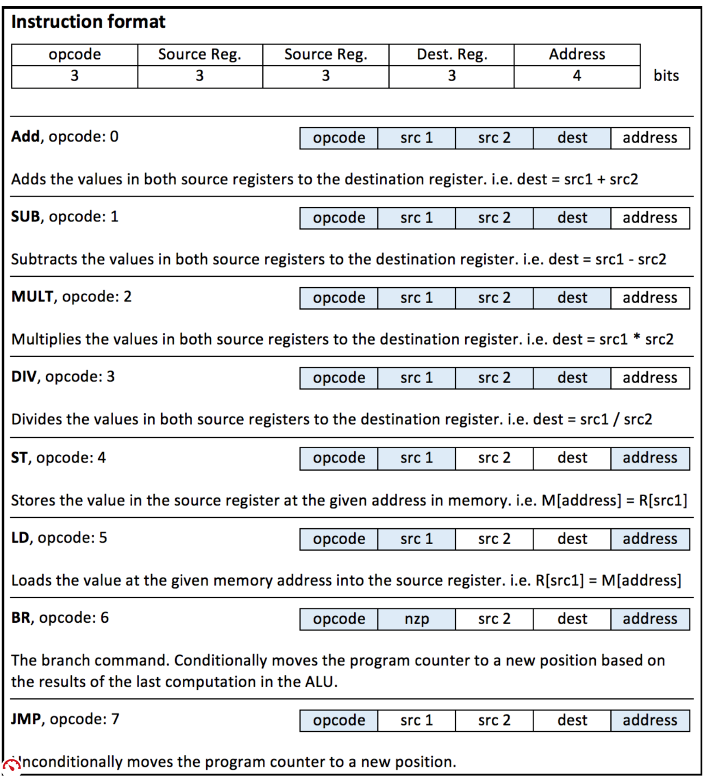
Instruction set

